Slide 1
NexaVM nCSSV:
The Agile, Unified Cloud Infrastructure Platform
Notes:
Good morning, everyone! I’m Linus, the pre-sales engineer from SIS distribution Hong Kong. This is actually my first time in Mongolia. and I’m so excited to be here. Today, I’ll be introducing NexaVM,a private cloud solution which comes with a cloud platform software and hypervisor. OKay. Let’s get started and take a look at NexaVM journey.

Slide 2
Contents
NexaVM nCSSV is a productized Infrastructure as a Service (IaaS) software that provides a unified platform to manage compute, network, and storage resources in data centers.
01
Features
03
Reference case
02
Scenarios
04
Q&A

Slide 3
01
Features

Slide 4




01
Features
The 4S standard of cloud platform
Simple
Smart
Strong
Scalable

Slide 5
01
Features
Simple - Lightweight Private Cloud
One-click download, complete installation and deployment within 30 minutes
One - physical machine can build a POC environment
1
2
SaaS
One- management node is sufficient to manage the entire cloud platform
One - operation and maintenance personnel (with general capabilities) can easily perform O&M
3
4
PaaS
One - click inspection for all - round health check and scoring
Guided operation prompts, with rich automated O&M functions
NexaVM nCSSV
5
6
IaaS

Slide 6
01
Features
Strong - A stable and efficient system architecture design
Full Asynchronous Design
Lock - free Architecture
Stateless Service
Fault Self - recovery
Thousands of threads can easily handle 10,000 concurrent tasks generated when creating 1 million virtual machines; a single computing node can easily manage 10,000 + servers.
The management node only processes requests without retaining states, enabling horizontal seamless scaling. Operation requests are automatically load - balanced. In extreme failure situations, the entire cloud platform can be quickly rebuilt.
Operations on different objects are processed in parallel, while operations on the same object are processed in series; it eliminates performance issues caused by distributed locked architectures and improves the processing performance of the cloud platform.
Multiple high - availability judgment mechanisms accurately identify whether a computing node fails, and automatically restart cloud hosts on other computing nodes to ensure business continuity.

Slide 7
Features
Scalable - Uniformly manage all kinds of resources and deliver on demand
01
Management: Heterogeneous Resource Platform Management
Can simultaneously manage NexaVM computing clusters, VMware vCenter resource environments, and public cloud environments
Multi - cloud Management Platform
PaaS Platform
OA System
Resource: On - Demand Delivery of Business Resources
Provides load balancing, elastic scaling, and dynamic scheduling to achieve elasticity and on - demand usage of business resource requirements.
NexaVM nCSSV Cloud Management Platform
Openness: Open Cloud Platform
Provides standard HTTP Restful APIs to connect with third - party cloud management platforms, PaaS platforms, and OA systems.
VMware Resource Environment
Public Cloud
NexaVM nCSSV Computing Cluster Nodes
Efficient Management - to - Computing Ratio
High - efficiency management - to - computing ratio. One management node can manage 10,000 computing nodes.
Local Storage
NAS/SAN
Distributed Storage
Cloud NAS

Slide 8
01
Features
Product highlights
Independent Intellectual Property Rights
One-Click Seamless Upgrade
Quick Installation and Deployment
Support of Existing Servers and Hardware-Independent
High Availability
Rich and complete functions
A complete self-developed and innovative cloud that is open-source with key code, autonomous, and controllable.
Allows you to perform one-click cross-version upgrades without affecting your business continuity.
Allows you to download NexaVM nCSSV from the official website and install the cloud on physical servers within just 30 minutes.
Allows you to deploy NexaVM nCSSV on devices that uses the x86 architecture and supports CPU virtualization.
Isolates management planes from data planes to avoid a single point of failure. Backup management nodes will be applied within seconds if any management node is disconnected, thus ensuring your business continuity.
Building on core IaaS functions (computing, networking, storage), it offers heterogeneous virtualization management, enterprise management, disaster recovery, elastic bare - metal management, visual resource orchestration, and an app center to meet unified cloud platform O&M and operation needs.

Slide 9
02
Scenarios

Slide 10



02
Scenarios
GPU Application
Promotes the efficiency of massively parallel processing tasks, suitable for compute-intensive scenarios such as AI, big data, visual computing, and graphics rendering.
High Performance
Provides high performance like that of physical devices while lowers host CPU consumption, suitable for scenarios that require high network and compute performance.
Intelligent O&M
Allows you to export bills and obtain intelligent O&M scenarios of cloud resources with one-click, greatly simplifying enterprise O&M and lowering the learning cost of O&M personnel.

Slide 11
02
Scenarios
Virtualization
Scenario Solution
Install NexaVM Cloud computing services on physical servers for resource integration;
Create cloud hosts through the NexaVM Cloud platform and deploy business services;
Customer Value
Integrate physical resources to support running more operating systems and services, reducing server investment;
Cut down hardware costs, data center costs, and power costs
VM
VM
VM
VM
VM
...
VM
VM
NexaVM nCSSV
NexaVM nCSSV
Computing node
NexaVM nCSSV
Computing node
NexaVM nCSSV
Computing node
...
Server
Server
Server
The performance of cloud hosts is close to that of physical machines with the same configuration
95%-99%
90%-93%
90%-95%
97%
CPU
Memory
networking
storage

Slide 12
02
Scenarios
Heterogeneous Platform Management & Multi-Region Governance
Scenario Solution
Unified management of NexaVM nCSSV computing clusters, VMware vCenter environments, and public cloud environments;
Unified management of NexaVM nCSSV resource environments across multi-regional branches, with multi-region image distribution;
Support migrating virtual machines from VMware environments to NexaVM nCSSV environments;
Manage resources via multi-tenant, project-based, and process-driven approaches, including expiration reclaim and metered billing;
Customer Value
Unified management + on-demand delivery to boost operational efficiency;
Cross-cloud migration to enhance business flexibility;
Improved management capabilities and efficiency through heterogeneous platform integration.
Organization A
Project A
Resource A
Organization B
Project B
Resource B
Organization C
Project C
Resource C
NexaVM nCSSV
NexaVM nCSSV Computing Cluster
VMware vCenter
Public Cloud

Slide 13
02
Scenarios
Innovation Business Enablement Platform
Scenario Solution
Deliver GPU - type cloud hosts via GPU passthrough and GPU virtualization;
Deliver physical server computing engines through bare - metal management;
Support application scenarios such as big data, artificial intelligence, and high - performance computing (HPC);
Customer Value
Reduce the operational overhead of basic resources required for innovative businesses;
Shorten the time - to - readiness for basic resources needed by innovative businesses;
Provide flexible resource scheduling to meet the demands of business innovation and transformation.
Big Data
Artificial Intelligence
High-Performance Computing
...
NexaVM nCSSV
NexaVM nCSSV
CPU Computing Cluster
Bare-Metal Server
Bare-Metal Server

Slide 14
03
Reference cases

Slide 15
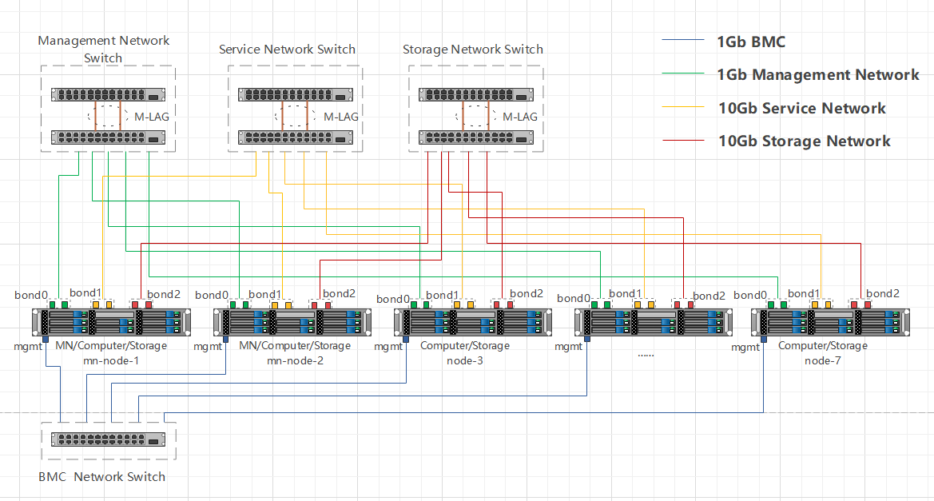
03
Reference cases
A European Operator Providing Global Telecommunications Services
Business Challenge
A UK-based telecom operator provides customized ICT services to global multinational enterprises. As its business expands, the company encountered several infrastructure bottlenecks:
Aging Virtualization Platform: Core systems were built on legacy VMware infrastructure, with outdated physical servers that are difficult to replace.
Rising Operational Costs : As system demands grew, maintaining legacy infrastructure became cost-intensive.
Low Delivery Efficiency : The legacy setup could not respond quickly to evolving online service needs, slowing business agility.
Project Solution
☁️ NexaVM Converged Cloud Deployment : Instead of upgrading the existing VMware environment, the customer deployed a new NexaVM nCSSV platform to support its core ICT services.
🔁 V2V Migration : Nearly 100 VMs (including the work order system, customer service, and official website) were smoothly migrated from VMware to NexaVM using built-in V2V tools.
🧩 Unified Cloud Architecture : The new platform centralizes compute, storage, and network management while simplifying future expansion.
Customer Value
✅ Lightweight & High Availability : NexaVM’s architecture ensures minimal VM performance loss while providing a stable and reliable foundation for critical services.
✅ VMware Replacement Ready : Seamless migration and operation reduce reliance on legacy platforms, avoiding vendor lock-in.
✅ Automated O&M : Built-in automation improves operational efficiency, reduces manual intervention, and enhances system responsiveness to new business needs.

Slide 16
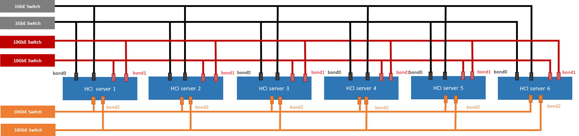
03
Reference cases
A Social Welfare Service Organization in HK
Business Challenge
The Customer is one of the leading non-profit organizations in Hong Kong, dedicated to providing rehabilitation, special education, and community support services.
OpenStack Complexity: The organization originally considered using OpenStack, but its high technical complexity and lack of local support made implementation difficult.
Rising VMware TCO: VMware's ongoing licensing and maintenance costs made the total cost of ownership unsustainable for a nonprofit organization.
Project Solution
6-Node NexaVM Hyper-Converged Infrastructure (HCI)： Deployed 6 NexaVM HCI nodes, simplifying cloud deployment and daily management.
Reduced Technical Threshold： NexaVM’s intuitive UI and simplified architecture enable internal IT teams to operate independently, without relying on deep OpenStack expertise.
Flexible Expansion, Lower Cost： HCI-based architecture supports elastic scaling based on budget and service demand, while significantly reducing TCO compared to VMware.
Customer Value
✅ Simplified Operations: Reduced technical complexity and easier daily management thanks to NexaVM’s user-friendly platform.
✅ Lower IT Costs: The switch to NexaVM significantly reduces licensing and operational expenses, helping control TCO.
✅ Scalable & Sustainable Architecture: Flexible capacity expansion supports long-term service growth while aligning with budget limitations.

Slide 17




03
Reference cases
The Largest Disciplined Service in Hong Kong
Enterprise Intranet
Internet
Business Challenge
To support its critical law operation business, Customer required a highly secure, stable, and scalable cloud infrastructure to:
Enhance IT modernization while ensuring data security and compliance with strict government regulations.
Provide reliable virtualization, network, and storage services to meet diverse departmental needs.
Ensure high compatibility and seamless integration with existing IT environments.
Firewall
Mgmt switch
VM switch
Project Solution
Private Cloud Deployment: New servers and centralized storage were procured to build a NexaVM private cloud in customer’s data center.
Multi-Tenant Management: NexaVM’s tenant management module enables different departments to access cloud resources efficiently.
Comprehensive Virtualization: NexaVM ensures secure, stable computing, storage, and networking services, meeting strict operational demands.
...
Node 1
Node 2
Node N
Customer Value
✅ Effortless Management: Intuitive interface, low learning curve, and simplified O&M, improving operational efficiency.
✅ Optimized Resource Utilization: Standardized cloud infrastructure enhances resource efficiency and reduces TCO.
✅ Fast Service Deployment: Cloud service components accelerate IT resource provisioning, enabling faster response to operational needs.
FC-SAN
switch
FC-SAN

Slide 18
04
Q&A

Slide 19
Thank You For Your Trust And Support

