Slide 1



Hybrid Cloud Platform
NexaVM nMCMP
Notes:
Buongiorno a tutti e benvenuti a questo webinar dedicato a NexaVM: la nuova frontiera della virtualizzazione per la tua infrastruttura IT.
Sono Luca Fiorin, Sales Manager di NexaVM, e oggi ho il piacere di guidarvi alla scoperta di una piattaforma che sta ridefinendo il modo in cui aziende e professionisti IT affrontano la virtualizzazione e il cloud.
Prima di tutto, grazie per aver dedicato un’ora del vostro tempo per essere qui con noi. Sappiamo quanto sia prezioso, e il nostro obiettivo è farvi uscire da questa sessione con una visione chiara e concreta di come NexaVM possa semplificare, rendere più sicura e più efficiente la vostra infrastruttura IT.
Oggi parleremo di chi siamo, di come nasce NexaVM, quali sono i nostri prodotti, perché rappresentiamo un’alternativa reale e solida alle piattaforme tradizionali come VMware, e infine vi mostreremo attraverso una live demo la nostra piattaforma.

Slide 2
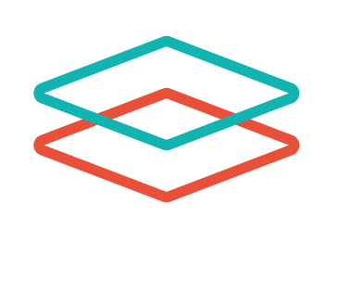
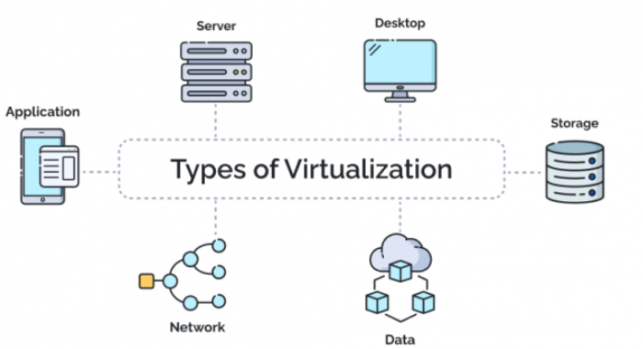
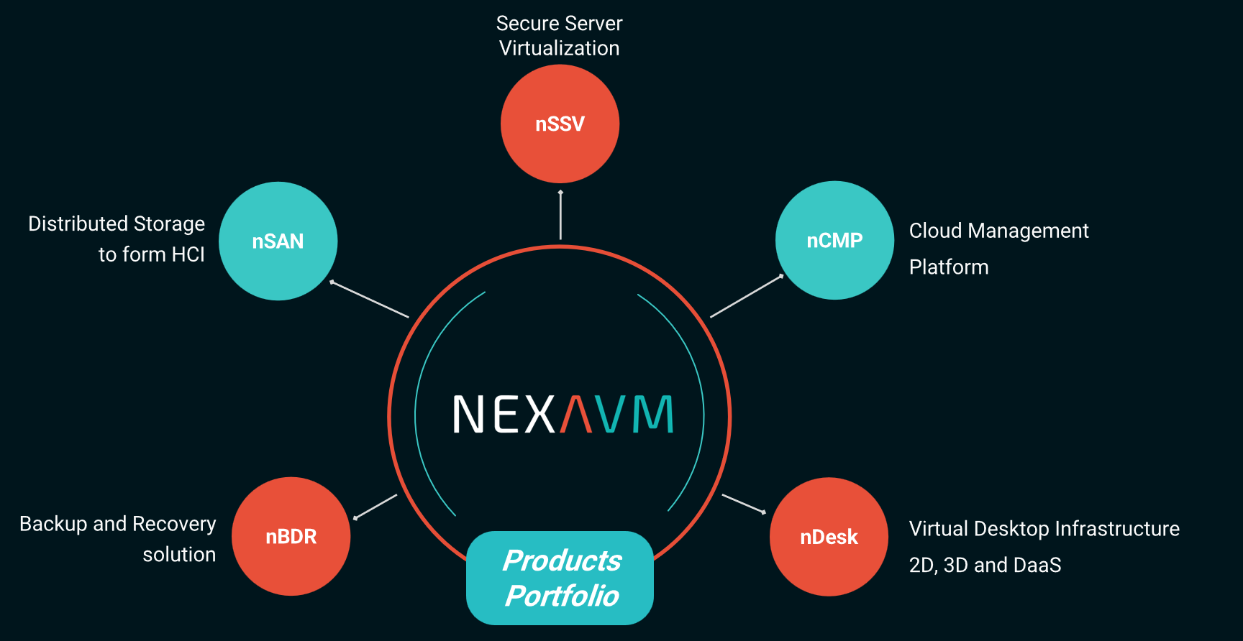
Product Portfolio
from IOT Edge to large cloud service providers
Notes:
Entriamo ora nel cuore della nostra offerta.
NexaVM non è un singolo prodotto, ma una suite completa di soluzioni che coprono ogni livello dell’infrastruttura virtuale.
Al centro del nostro stack c’è nSSV – Secure Server Virtualization, il nostro hypervisor proprietario, il cuore pulsante della piattaforma.
- nCSSV – Cloud Software Virtualization, la nostra piattaforma per cloud privati e ibridi, ideale per chi vuole gestire in modo autonomo le proprie risorse;
- nSAN – il nostro storage distribuito, che garantisce affidabilità e scalabilità per infrastrutture iperconvergenti;
- nBDR – la nostra soluzione di backup e disaster recovery;
A questi moduli si aggiunge un portfolio di prodotti complementari che arricchiscono ulteriormente la nostra proposta:
- nSDS, che estende le capacità del nostro storage includendo object storage S3, file storage e cluster distribuiti;
- nCMP, la Cloud Management Platform che consente di erogare servizi cloud in modo centralizzato;
- nMCMP, la Multi Cloud Management Platform, pensata per semplificare la gestione di workload distribuiti tra più cloud provider;
- e infine nDesk, la nostra soluzione di Virtual Desktop Infrastructure, per abilitare il lavoro remoto in sicurezza.
In sintesi, NexaVM offre una piattaforma completa, capace di coprire tutte le esigenze di virtualizzazione, storage, cloud e gestione multi-ambiente.

Slide 3

Why NexaVM Multi-Cloud Management Platform
70% OPEX reduction
Reduce Waste
Faster TTM
reduce workload and mistakes
identify wasted resources
TTM reduced up to 90%
online automated deployment
life cycle management of resources
customize life cycle management automatically
one click deployment of resource and application
360 degree of cost control
predefined policies
manage workload across clouds
comprehensive billing analysis
visualize approval process
integrate and manage different Isolated Systems.
regular optimization report
follow ISO/IEC 20000
NEXAVM Technologies AG ©2025 All Rights Reserved
Notes:
Il cuore tecnico della nostra piattaforma è nSSV, il nostro Secure Server Virtualization Hypervisor.
È la base su cui tutto si fonda: performance, sicurezza e stabilità.

Slide 4
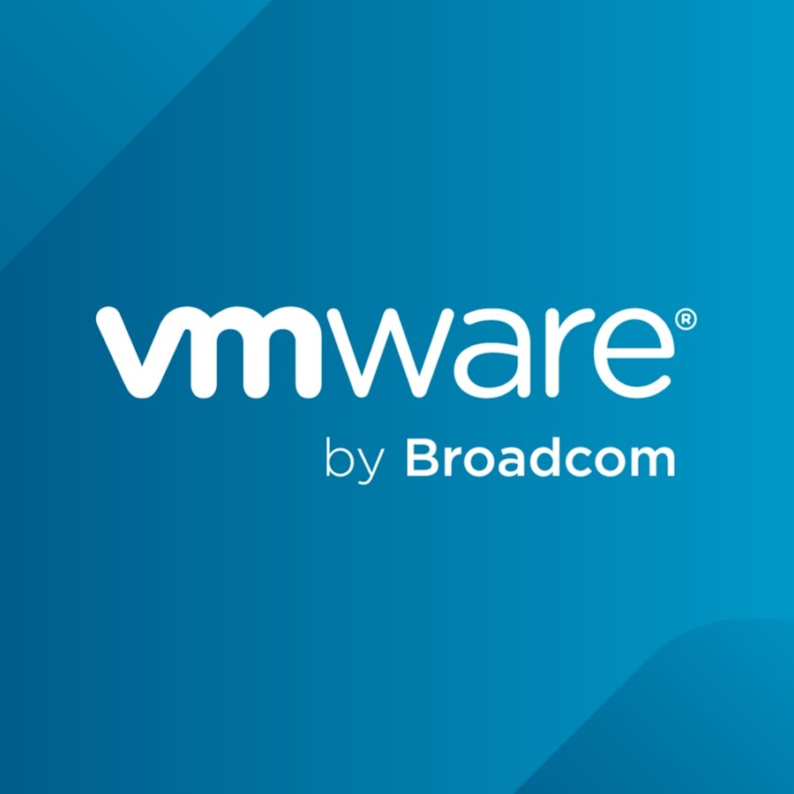

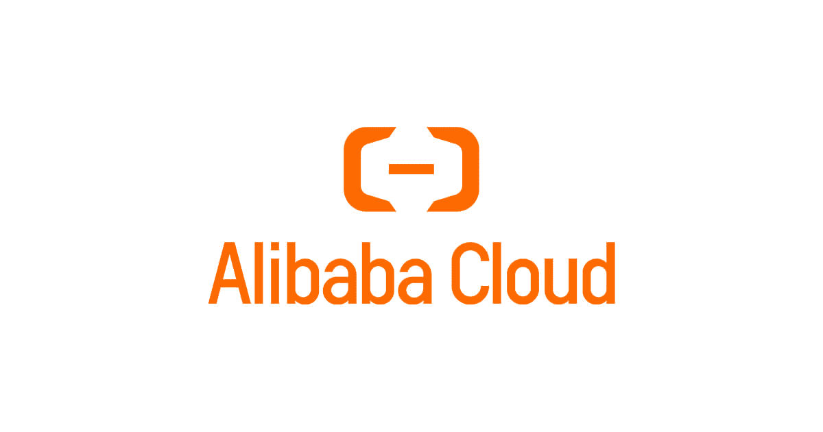

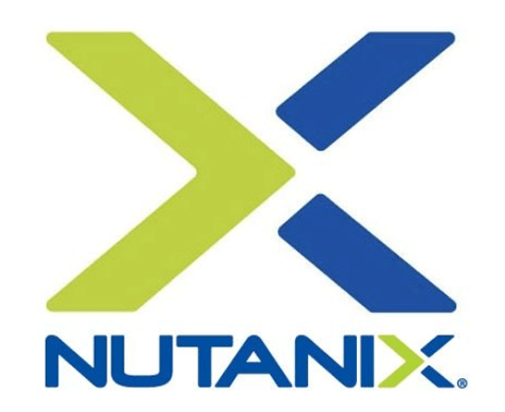
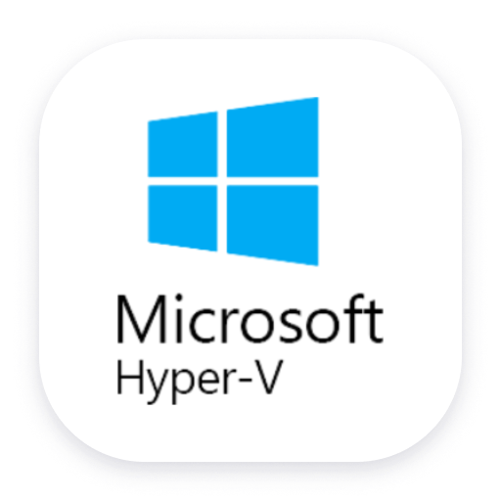

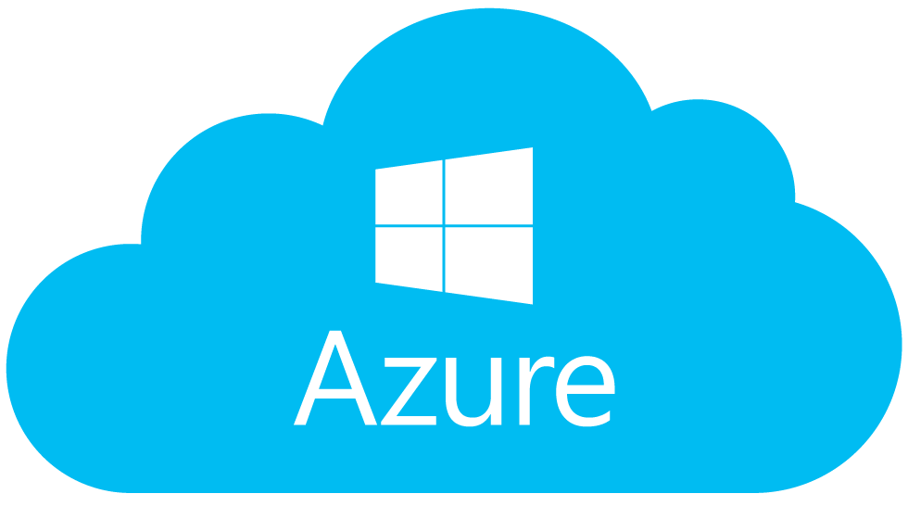
Target Customer: Cloud Service provider or large enterprise
Tenant 1-N
self service portal
Admin 1-N
platform management portal
Hybrid cloud construction
One customer has both private infrastructure and public cloud for their business systems
NexaVM nMCMP
Private Infra Silos
Public Cloud
Consolidate Management Infra-Vendors
Multiple clusters of technologies from different vendors
i.e NexaVM/Vmware/Nutanix/HyperV.....
NEXAVM Technologies AG ©2025 All Rights Reserved
Notes:
Il cuore tecnico della nostra piattaforma è nSSV, il nostro Secure Server Virtualization Hypervisor.
È la base su cui tutto si fonda: performance, sicurezza e stabilità.

Slide 5
nMCMP Product Architecture
Finance
Logistics
Manufacturing
Operator
Government
Education
Retail
Internet
Resource management
Self-service module
In-depth service operation
Service operation and maintenance
Multi-cloud access
Service Catalog
Electronic work order
Account Management
Division of authority
Refined monitoring
Customize UI
Lifecycle management
Apply on demand
Order Management
Multilevel organization
Process Approval
Alarm management
https configuration
Resource pooling
Script repository
Automated deployment
Metering and billing
Cost allocation
Optimization recommendations
Third Party Certification
Resource Operations
Gateway Proxy
Resource Identification
Budget Settings
Billing Statistics
Visual large screen
Expansion Center
Notes:
Il cuore tecnico della nostra piattaforma è nSSV, il nostro Secure Server Virtualization Hypervisor.
È la base su cui tutto si fonda: performance, sicurezza e stabilità.

Slide 6
Resource Lifecycle Management
Multi-cloud management
& data center management
Multi-Infra/Cloud
Consolidation
Southbound adaptation,
From application, creation, delivery, operation and maintenance to final release, cloud resources can be controlled throughout the life cycle in the main console
Many resources belonging to different organizations are summarized to realize convenient resource management by division of domains
Supports common operation and maintenance operations of various resources
Match different usage scenarios through multi-cloud management and data center management
Resources Allocation
Resources
Computing
Storage
Network
Build positive expectations
Unified management
Operational alignment
Resources
Recycling
Notes:
Il cuore tecnico della nostra piattaforma è nSSV, il nostro Secure Server Virtualization Hypervisor.
È la base su cui tutto si fonda: performance, sicurezza e stabilità.

Slide 7
Self-service Portal
Cloud On Demand
One-stop self-
service for users
ZStack CMP integrates various products of the cloud platform to provide comprehensive one-stop self-service capabilities and support experience for end users
Enterprise IT services complete the transformation from "over-the-counter " to "self-service"
Centralized management and self-service control of various heterogeneous cloud network resources to help customers achieve refined cloud business management granularity
Business Applications
Deployment distribution
Self-service
configuration
control
change
recycling
Cloud Hosting Services
Object Storage Service
Database Services
Security service
SLB Services
Self-service application for cloud products
Standardized centralized and automated
management of cloud resources across clouds
Intelligent recommendation of cloud products
Server
Database
Storage
Business Unit
Service Catalog Self-service Application
Flexible
binding
org- structure
Division
Business module
Business system abstract construction
Business Label
On-demand intelligent selection generation
Divided on demand
Visual service orchestration
Notes:
Il cuore tecnico della nostra piattaforma è nSSV, il nostro Secure Server Virtualization Hypervisor.
È la base su cui tutto si fonda: performance, sicurezza e stabilità.

Slide 8

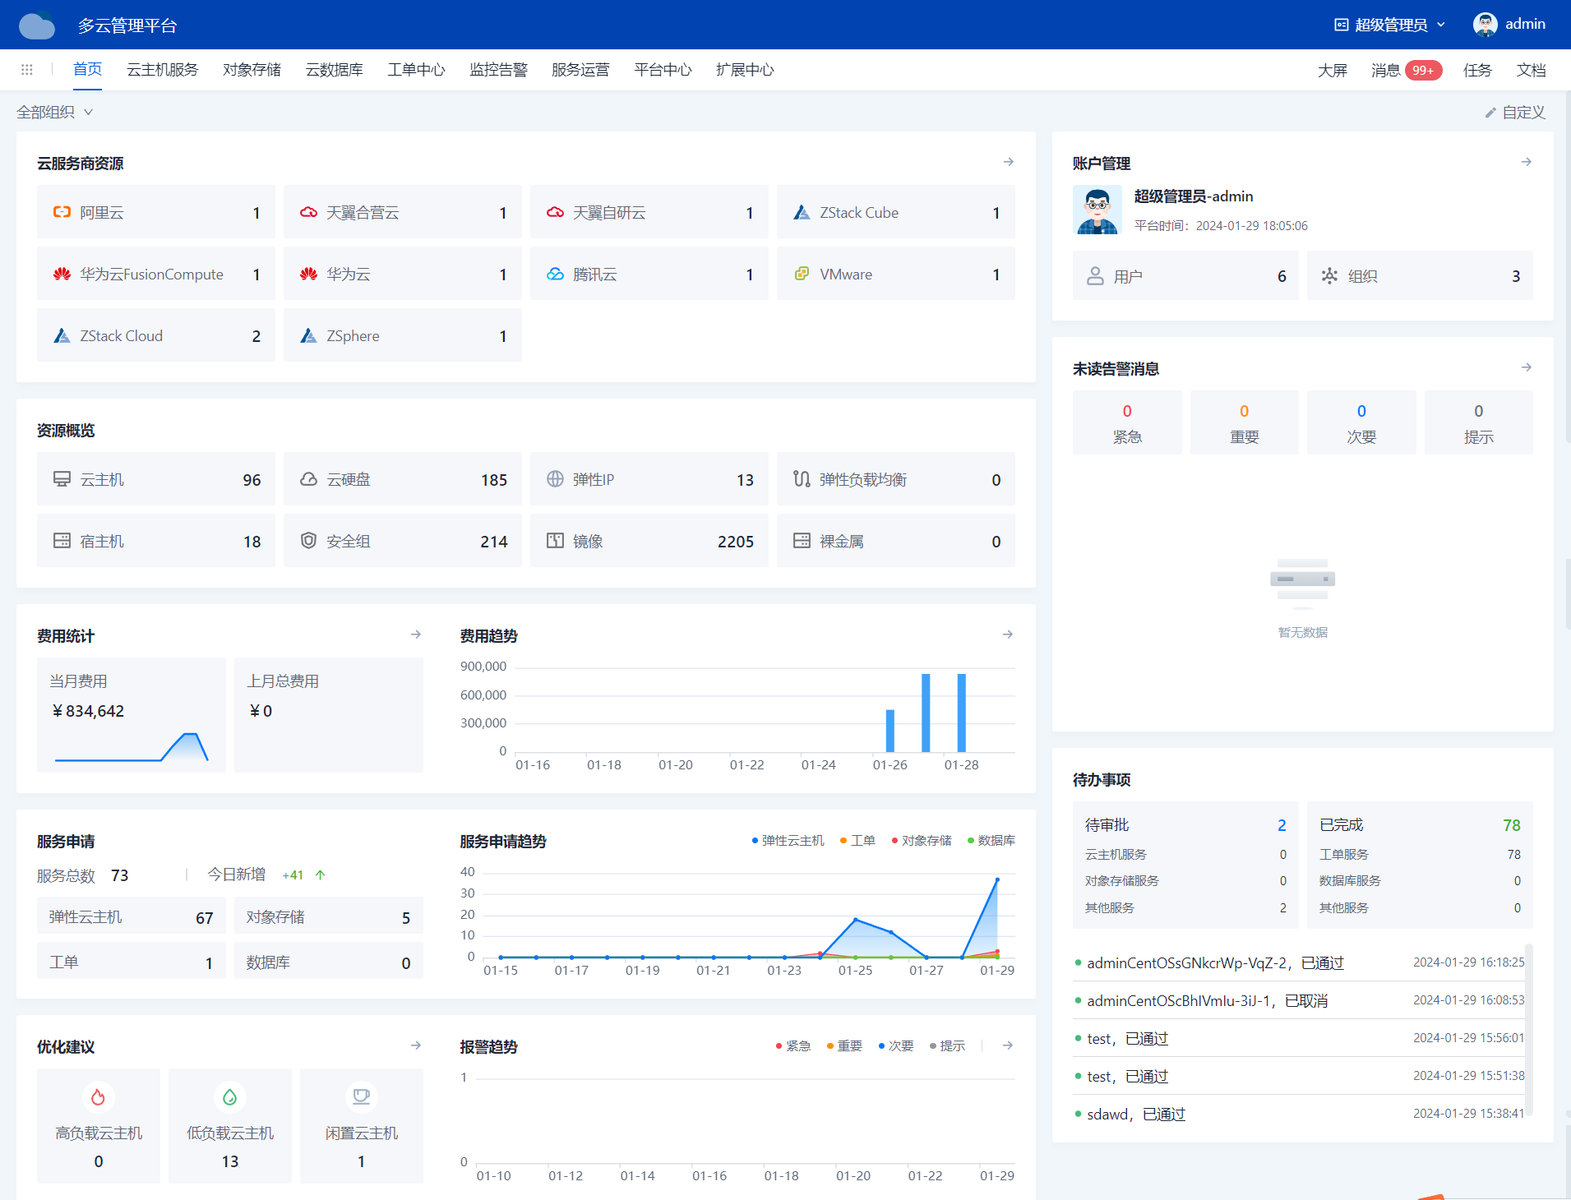
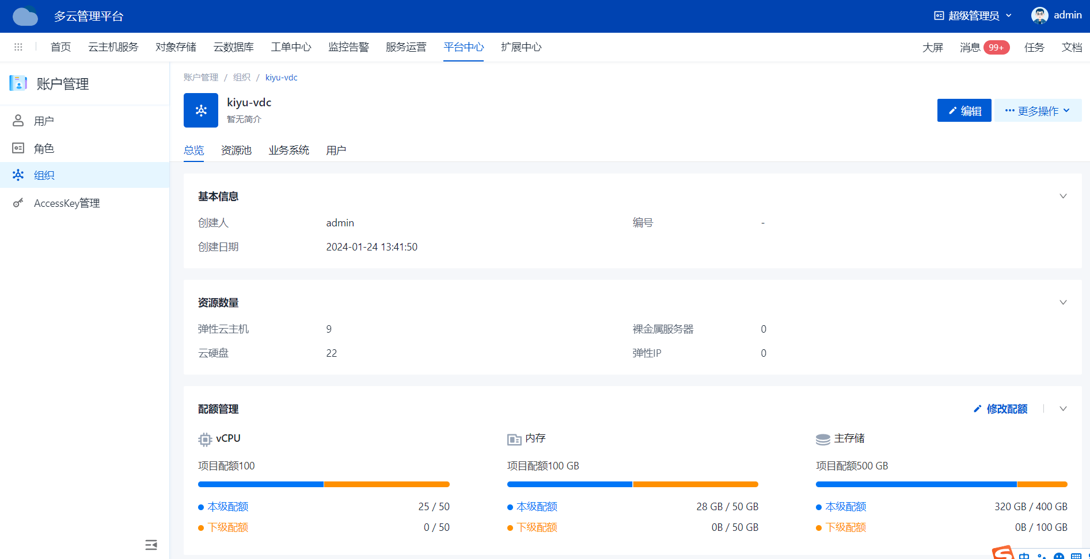
Decentralization of organizations, business systems, and tenants
Different view for different users
People with different roles have different work scenarios. After logging in, they can have different corresponding views, display and provide different functions and resources, and visible manageable scope
Decentralized and subdomain management
When a user is located in different organizations, he can have multiple roles. Resource access needs to be decentralized, that is, different people need to isolate access to a set of different resources
Role permission configuration
Users have different role permissions in multiple resource domains. You can perform separate permission control for roles
Notes:
Il cuore tecnico della nostra piattaforma è nSSV, il nostro Secure Server Virtualization Hypervisor.
È la base su cui tutto si fonda: performance, sicurezza e stabilità.

Slide 9
Simplified Approval Process
Flexible configuration of
business approval process
Administrators can formulate standard business processes and define, publish and manage them. At the same time, they can freely define objects that need approval such as cloud resources and cloud services, and associate them when they are created and published
When end users apply for relevant catalogs from self-service, they need to complete the approval according to the approver and approval level defined in the process
Automatic execution
Receipt and filing
Node Approval
Matching rules
Service Requisition
Directory creation
Notes:
Il cuore tecnico della nostra piattaforma è nSSV, il nostro Secure Server Virtualization Hypervisor.
È la base su cui tutto si fonda: performance, sicurezza e stabilità.

Slide 10
Advanced Billing management
Billing Rules &
Billing Display
business decision-making for enterprises
The system can edit resource billing rules and ticket billing rules for cloud platforms, and supports public cloud bill synchronization and setting allocation rules to calculate consumption in real time
By increasing the diversity of billing templates, it fits the billing mode of users in multiple scenarios, realizes metering billing and provides support for future cloud resale scenarios
Supports configuring budgets for different cloud platforms and checking whether resource usage exceeds the limit
Billing management can record and count the expenditure of various resources of the organization, so as to understand the financial situation and spending habits of the organization
Calculate
Resources
Storage
Resources
Network
Resources
Resource Accounting
Cost allocation
Order settlement
Billing Overview
Billing Type & Billing Granularity & Settlement Rules & Billing Grouping
Notes:
Il cuore tecnico della nostra piattaforma è nSSV, il nostro Secure Server Virtualization Hypervisor.
È la base su cui tutto si fonda: performance, sicurezza e stabilità.

Slide 11



Custom Script
Script Library
Change password
Gateway Proxy
Modify IP
Script
maintenance
Install middleware
Serve
Apply for
direct
Execute
Execute
Record
View configuration
Daily operation
and maintenance
…
Custom scripts implemented through ansible are a very useful tool to help users realize various automated management and quickly implement complex tasks
Scripts are maintained and managed through the script library. Users can freely write required scripts and configure executable groupings, and support modifying parameters during execution
Help users quickly implement complex administrative tasks
Help users quickly expand application and service capabilities
Help users realize automated security
Notes:
Il cuore tecnico della nostra piattaforma è nSSV, il nostro Secure Server Virtualization Hypervisor.
È la base su cui tutto si fonda: performance, sicurezza e stabilità.

Slide 12
Operation and maintenance monitoring
Intelligent operation and maintenance
realizes quality difference delimitation
Realize plug-in full-stack access capabilities for massive data, minute-level granularity real-time display, and dynamically build resource quality monitoring
Provide comprehensive diagnostic information, effectively delimit poor quality nodes, and assist in group obstacle location and troubleshooting
Combined with outgoing methods such as emails and text messages, real-time alarm analysis and push are carried out to improve the efficiency of troubleshooting
Alertmanager
SMS Notification
Node Exporter
Prometheus
Grafana
Native indicators
Optimization advices
Email notification
Notes:
Il cuore tecnico della nostra piattaforma è nSSV, il nostro Secure Server Virtualization Hypervisor.
È la base su cui tutto si fonda: performance, sicurezza e stabilità.

Slide 13
NexaVM nMCMP
AI-ready Cloud
Notes:
Il cuore tecnico della nostra piattaforma è nSSV, il nostro Secure Server Virtualization Hypervisor.
È la base su cui tutto si fonda: performance, sicurezza e stabilità.

