Slide 1

Sangfor HCI and Cloud Solution Sales presentation

Slide 2



Smooth Trip to the future
SDIT
Enterprise Cloud
Hybrid Cloud
Private
Hybrid
Sangfor HCI
Traditional IT
……
VDI
Docker
Notes:
Half of our R&D staff is working on virtualization and cloud. HCI is just one part of this grand vision, we believe the ultimate data center form will be hybrid cloud. Customer can leverage the economics of public cloud and control of private cloud, they can have the best of both worlds with Sangfor HCI. That said, Sangfor HCI is able to evolve smoothly to cloud, the grand plan is like this roadmap shows, customers’future is laid out by Sangfor and they only need to focus on their core competence.

Slide 3
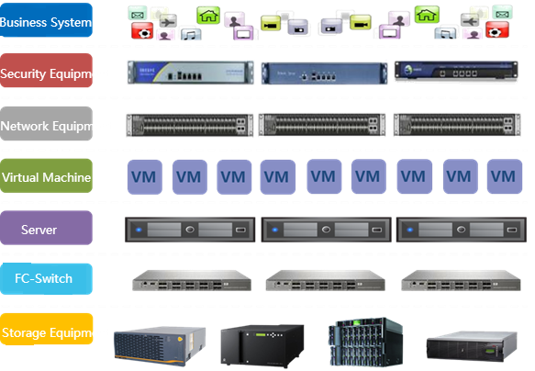





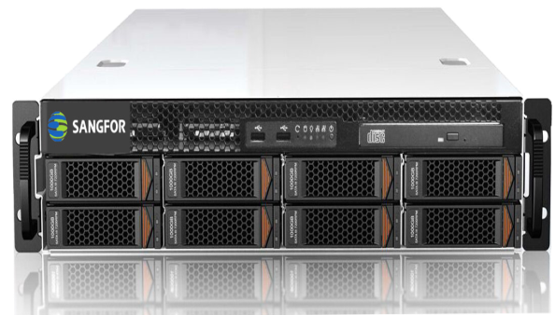
Pave the way to software defined IT Infrastructure
NFV
Storage
Virtualization
Network
Virtualization
Server
Virtualization
Traditional Data Center
Software Defined Data Center
Notes:
软件定义数据中心（Softwares Defined Data Center，SDDC）解决的最核心的问题是让用户以更小的代价来获得更灵活的、快速的业务部署、管理及实现。常说的互联网模式在技术核心上的问题几乎都可以归结为SDDC，
敏捷性(agility): 更快、更灵活的业务支撑与实现（以及软件开发模式的优化与变更）；
弹性(Elasticity)：随业务需求的资源的动态可伸缩性（水平+垂直）；
省钱(Cost-efficiency)：软件实现避免了重复硬件投资和资源浪费。

Slide 4





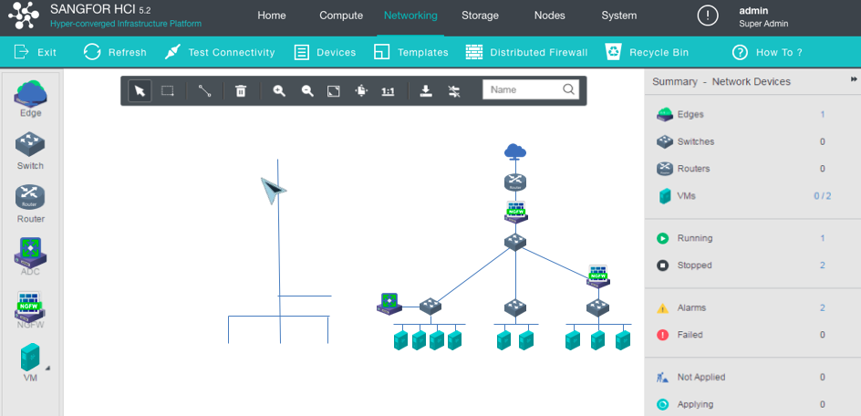




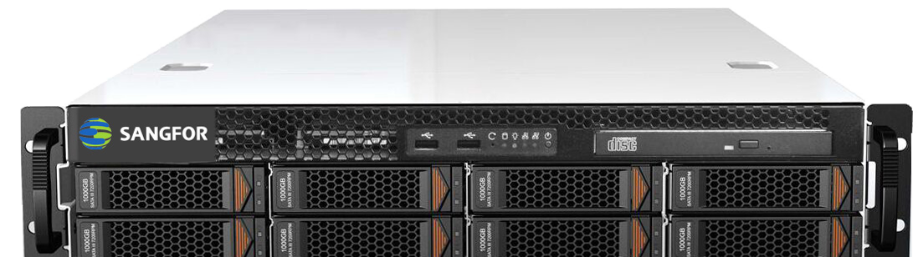
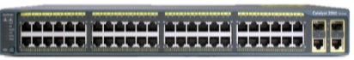

Fully Software Defined IT with Sangfor HCI
O&M
Hardware consolidation
Unified Management
Massive TCO reduction
Secure and stable
Future-proof
Management
Infrastructure
Support
Notes:
需求、疑虑、竞争优势、reference, 数据安全（Af数据安全的能力，Vm防火墙），
所画即所得，平滑演进
客户选择我们的案例？重起一页还是单独讲？
When customer select vender for expansion or build new application, mostly they consider how to protect their investment and smooth integrate with current infrastructure. Compare with other vender, 1, Sangfor can reuse current severs when installing HCI software without changing existing topology; 2,one step evolution to cloud。
In Malaysia, one government customer consolidate 64 severs with only 4 HCI server， 90% of hardware reduction build a really easy way of IT infrastructure.

Slide 5








Sangfor HCI defines the Future IT Architecture
Fully Converged, including Hardware and Management
INNOVATION
3rd Gen of HCI: Sangfor HCI
2nd Gen of HCI: VMware (partially)
1st Gen of HCI: Nutanix/Simplivity
Compute
Storage
Network
Security
Notes:
但不是每个厂商的超融合、都能实现这样的运用方式，这需要在计算、网络、存储和安全四个层面实现全面的整合，目前大家听到比较多的是计算和存储的融合（点击），我们称之为超融合的1.0阶段，但它无法满足数据中心复杂网络环境下业务弹性迁移的需求(dianji)，所以就有了整合网络功能的超融合2.0，但这样还不够（dianji），因为一个完整的数据中心必然有大量的网络优化和网络安全设备，所以深信服交付了更完整的超融合3.0形态，用标准x86服务器和交换机就能构建一个云化数据中心.
For the fundamental product HCI,What makes us different? The first, Currently in market, some vender have converged compute and storage, we said HCI 1.0, some vender have converged network function, it’s HCI 2.0 but still lack of another essential compoonent—security， as well as unified management. Sangfor HCI 3.0 have converged all those 4 parts, and provide the real complete software defined DC.
-强调一下管理的融合，用我们自己的框框

Slide 6
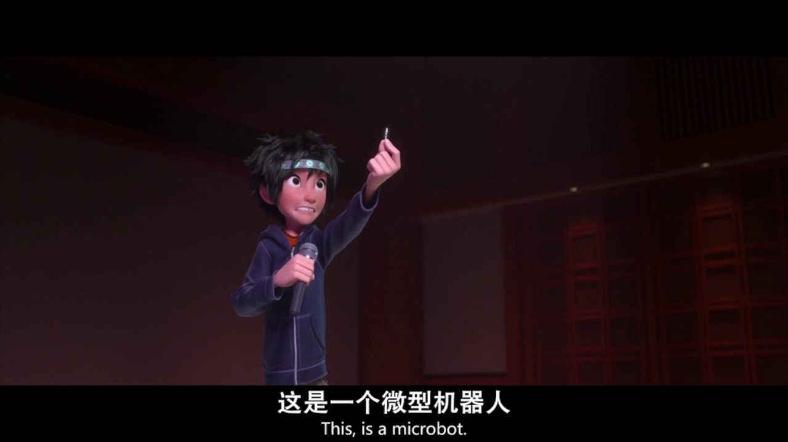
1 Server = 1 Micro DC
NFV
Storage
Virtualization
Network
Virtualization
Server
Virtualization

Slide 7
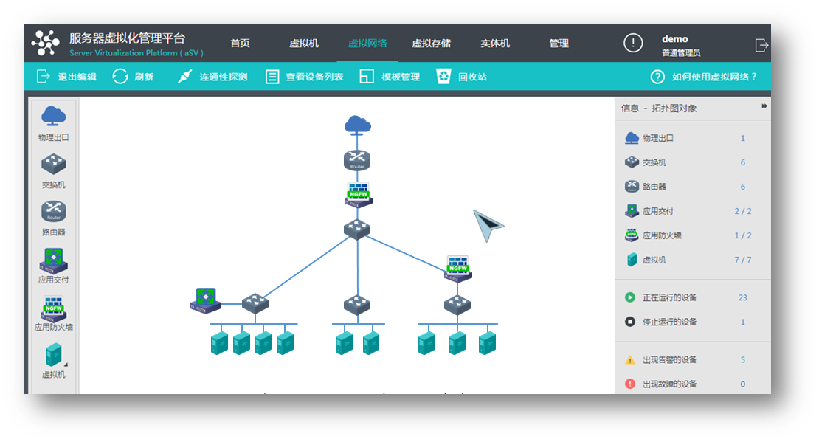
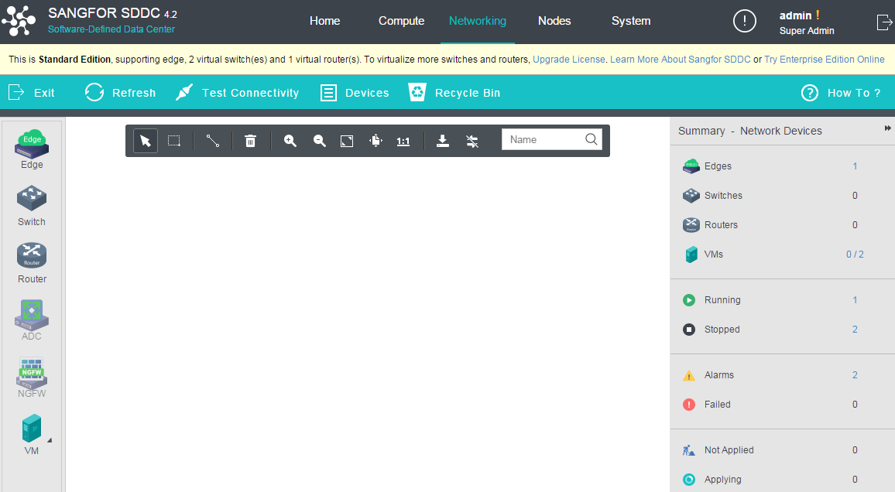


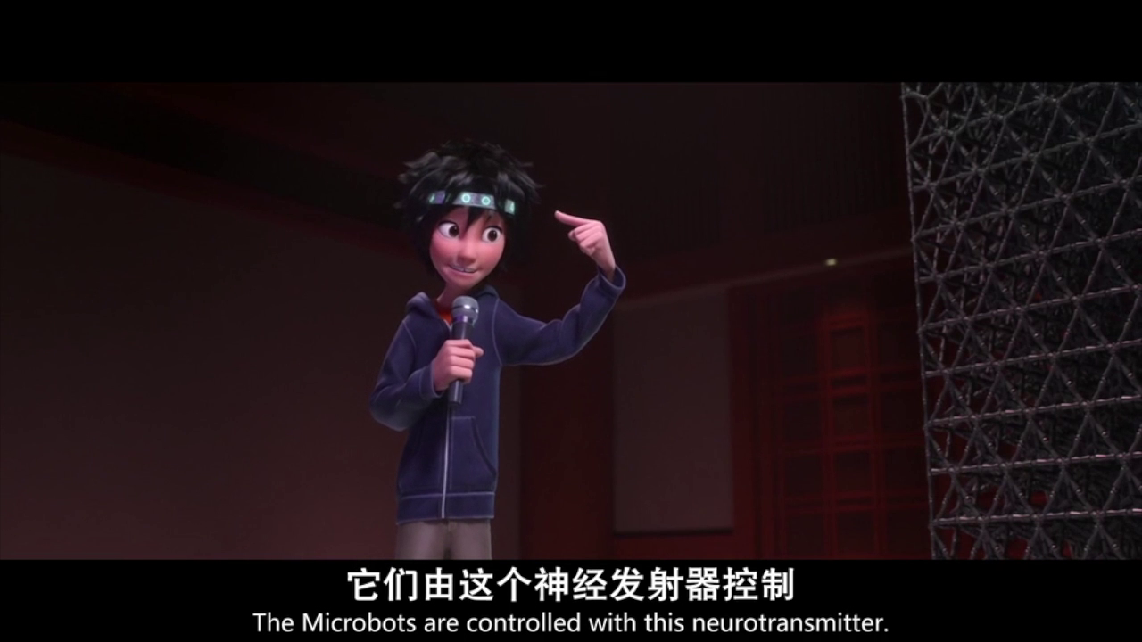





Unified UI Controller
Notes:
模块化是指计算虚拟化、网络虚拟化、存储虚拟化、网络功能虚拟化等多种技术的独立设计，而微架构，就是将这些技术进行完美融合，将整个数据中心融合到一套设备中，帮助用户打造极简、随需应变、平滑演进的IT新架构，这就是深信服的超融合架构，接下来我们一起来直观感受下深信服超融合是如何实现极简、随需应变、平滑演进的，包括前面我们提到对于短期需要直接建设私有云数据中心的用户，我们是如何基于超融合架构来构建私有云数据中心的

Slide 8
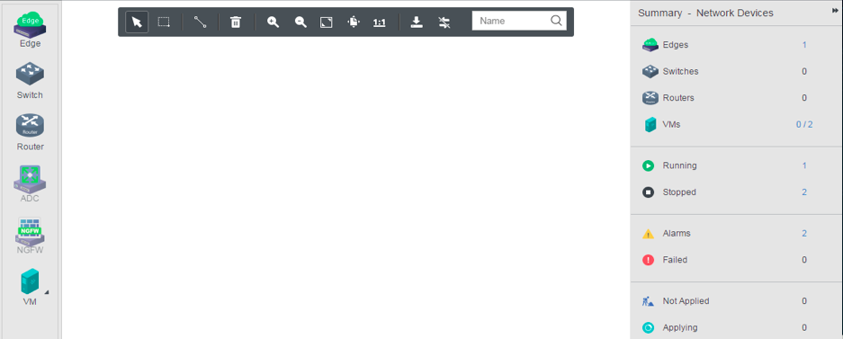
What You Think is What You Get
Notes:
This feature is the highlight of Sangfor HCI management, it’s unique and marvelous. We call it “what you draw is what you get”. Just like the animation shows here, basically you can draw your data center topology right on the management platform with your mouse on your laptop. On the left are some of the virtual components like virtual firewall, virtual router, virtual machines, you can drag them to the map and draw lines between them to connect, and make the configurations directly even without leave the map. Moreover, it‘s visualized，you can see the real time traffic flow on the topology and real-time running status of all the virtual devices. O&M is made a lot easier with Sangfor HCI.

Slide 9
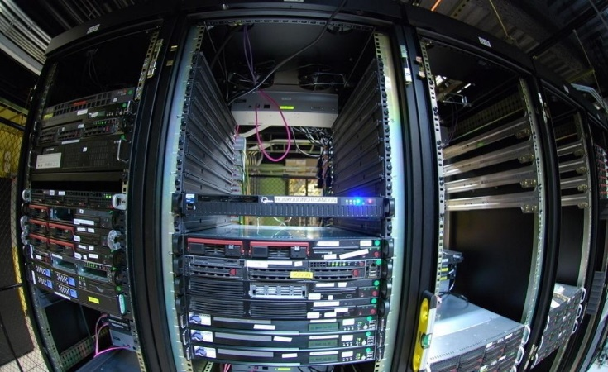

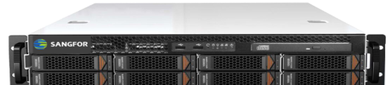
What are the Business Benefits？
All kinds of complicated storage, server and network devices.
Power-On
=
Service-On
TCO (Total Cost of Ownership) reduction up to 80% !
TTM (Time to Market) from 1-6 months to hours/days !
Notes:
TCO for 5years includes hardware, software, license, support, power,cooling, space, human resource required to deliver, design, deploy and operate
TTM time required to launch a business system to the market, i.e launch a new website.
2 things are what customers concern most, one is TCO, the other is TTM.TCO means money,with Sangfor HCI, hardware footprint can be reduced dramatically, no more complex proprietary hardware sitting in the data center sucking power and space, and management is a lot easier with one unified management platform, operational cost is cut significantly as well as initial cost. The second thing is time to market, before launching a new application could take several weeks or even months since different parts of your data center may come from different vendors. Now it’s all shortened to hours/days with Sangfor HCI, everything is packaged and ready to run when customers get their HCI.

Slide 10














Sangfor Cloud Solution Architecture
Application
Platform
ERP
CRM
Big Data
MES
SCADA
Mail
Web Server
Operation & management
Production management
Office management
Management
Platform
Resource Management
Cloud Service Platform
Self Service Portal
Process
VPC Service
Data protection
VM Recovery
Virtual Desktop
Application
Tenant
Charge
Maintenance
Visibility
One button deployment
Hyper-Converged Infrastructure
X86 Server
Compute
Virtualization
Storage Virtualization
Network
Virtualization
Security
Virtualization
GPU
Virtualization
Hardware

Slide 11
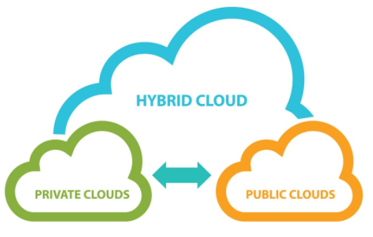



Keep innovation for better
1. Complete Hybrid Cloud for Infrastructure, ease of migration, DR, backup in a secure and smooth manner across different data centers and cloud.
2. Provide more valuable business analytic reports as well as application performance management
3. Intelligent security solution integrated for business systems
4. visulize, automate and simplify IT operation for CSP/IT admin and make the solution as easy as for consumer products

Slide 12
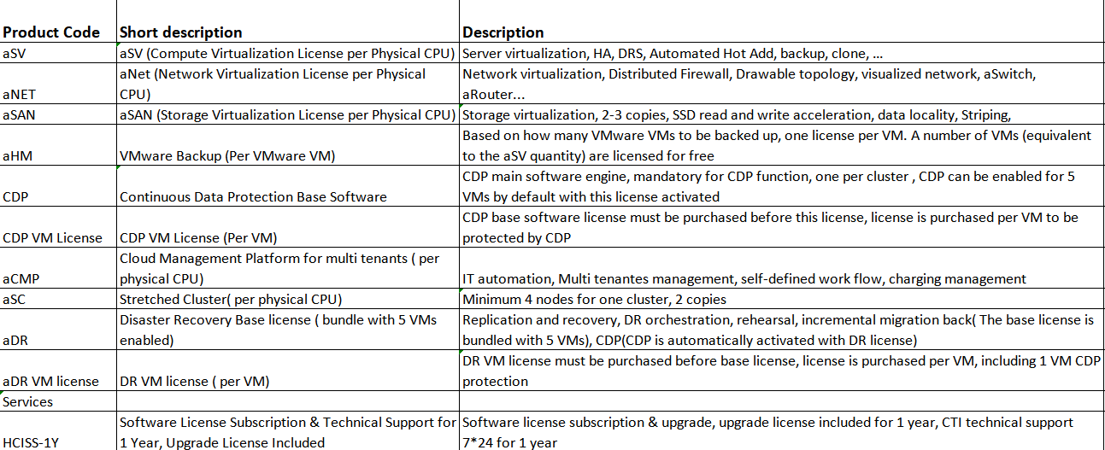
Sangfor HCI software modules simple but full of features
one license for each module including enterprise plus features
a lot of features are given at cost free to increase the adoption of complete SD IT solution
Notes:
LOGO化, business values
Legacy servers have been running more than 3 years, lacking of performance or capacity
Physical servers or standalone virtualized servers with no shared storage, no HA or backup
No technical professional or only 1-2 people managing the whole data center
N-tier consolidates to 1-tier, massive hardware footprint reduction
Scale-out architecture with no performance or capacity compromise
Built-in HA and integrated backup to guarantee business continuity and data integrity
Intuitive web-based management console, massively reduce O&M workload

Slide 13









Scenario 1: on-premise DC new or consolidation of old
Sales triggers
Integrated Solution
Insufficient technical professional
Time to Market
Higher Performance
TCO
USP of Sangfor HCI
Be a solution provider, not a box mover
Intelligent and intuitive operation
Fast time to market with smart automations
Higher efficiency of performance
Unmatchable TCO
Traditional Data Center
Sangfor aCloud
Router/Switch
Security
Switch
...
...
Server
...
Mgmt.
FC
Storage
Notes:
LOGO化, business values
Legacy servers have been running more than 3 years, lacking of performance or capacity
Physical servers or standalone virtualized servers with no shared storage, no HA or backup
No technical professional or only 1-2 people managing the whole data center
N-tier consolidates to 1-tier, massive hardware footprint reduction
Scale-out architecture with no performance or capacity compromise
Built-in HA and integrated backup to guarantee business continuity and data integrity
Intuitive web-based management console, massively reduce O&M workload

Slide 14
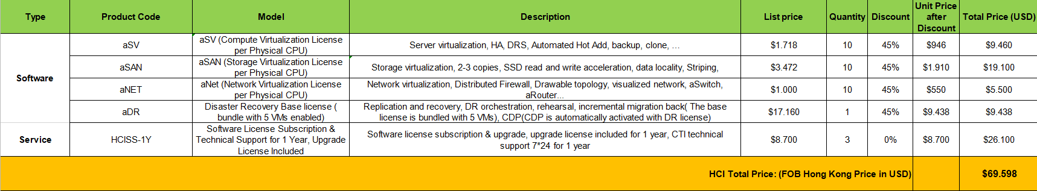
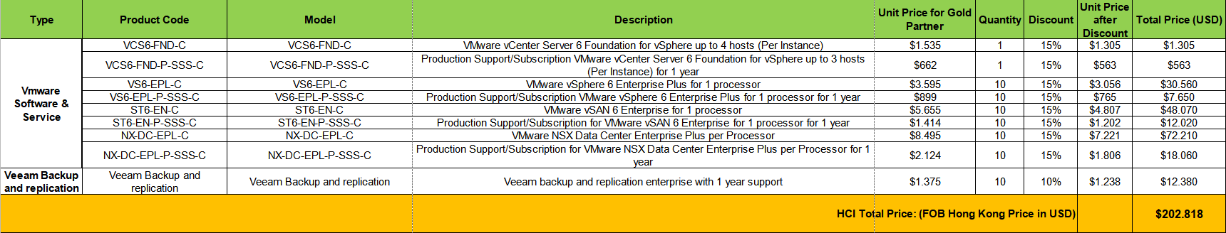
Typical scope of work
Main advantages:
1. Integrate technologies into single solution
2. Simplify the operation with automation and visualization
Business value:
1. Lower CAPEX and OPEX
2. Faster TTM
make the best technology affordable for more
Notes:
LOGO化, business values
Legacy servers have been running more than 3 years, lacking of performance or capacity
Physical servers or standalone virtualized servers with no shared storage, no HA or backup
No technical professional or only 1-2 people managing the whole data center
N-tier consolidates to 1-tier, massive hardware footprint reduction
Scale-out architecture with no performance or capacity compromise
Built-in HA and integrated backup to guarantee business continuity and data integrity
Intuitive web-based management console, massively reduce O&M workload

Slide 15
Friendly remind
Don't focus on replacing vSphere and vCenter with our aSV, the value is too small for a vmware customer. Always use more value to compete with less value!
hypervisor + at least one of the following features in demand
HA
backup
DR
Storage
microsegmentation
security(vNGAF and ES with correlation)
Cloud Management
better business analytics
urgent TTM
the bigger the scope of consolidation, the higher chance to win against vmware as well as any other HCI players.

Slide 16
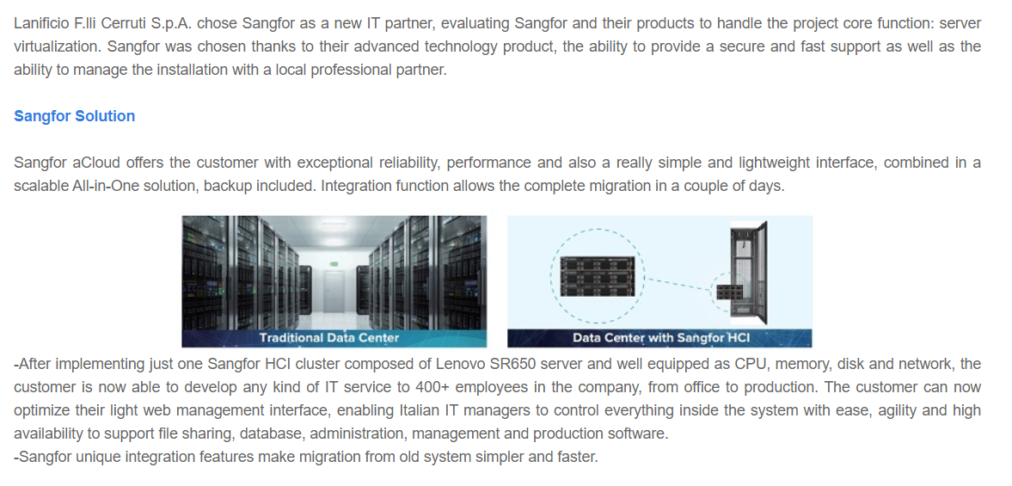
Case Sharing-Lanificial Cerruti
Notes:
aCMP: Multinet
DR: WCE, Secui

Slide 17
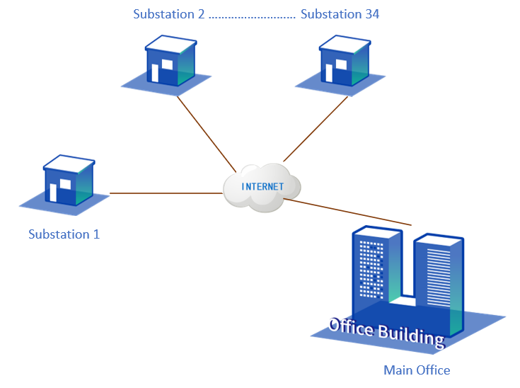
Case sharing: OETC （Oman Electricity）
Notes:
67家渠道卖了2单及以上aCloud 渗透率2.5%
83家卖过1单
总共2605家渠道
卖过aCloud的渠道 5.75%

Slide 18
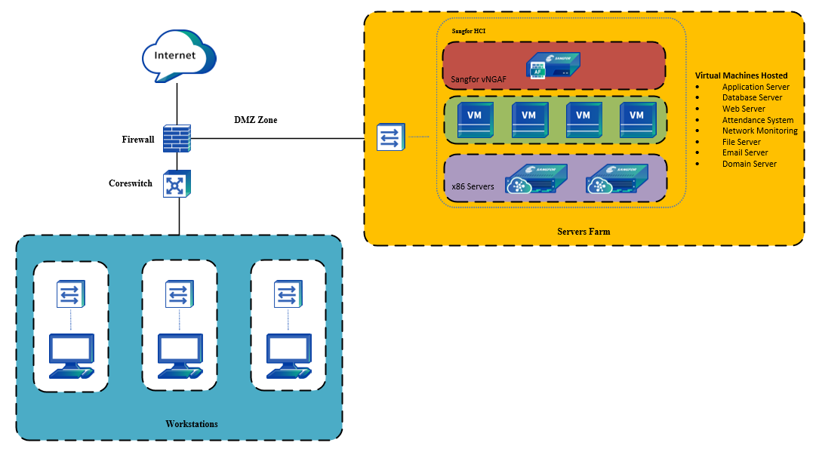
OETC Main Office
8 high performance Servers in 1 HCI cluster carrying the business systems for the whole company
Firewall is enabled to protect those services at Head Quarter
Notes:
67家渠道卖了2单及以上aCloud 渗透率2.5%
83家卖过1单
总共2605家渠道
卖过aCloud的渠道 5.75%

Slide 19
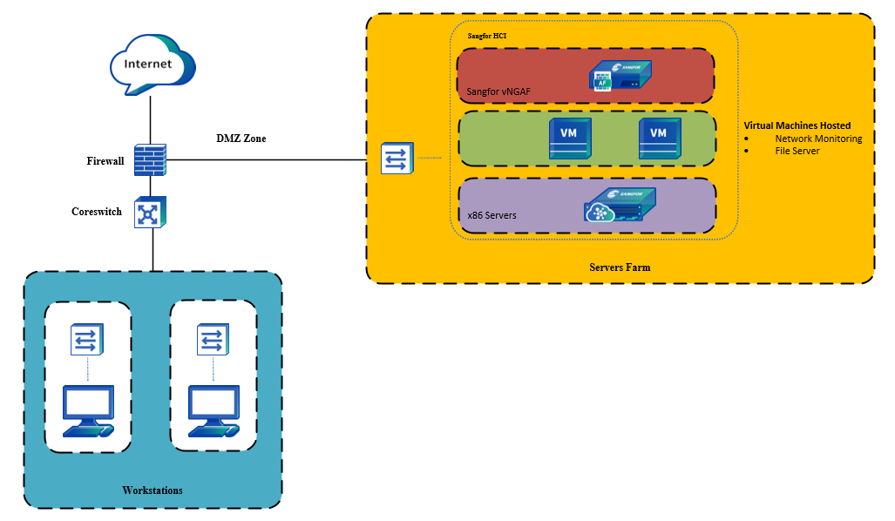
OETC Substation Office
1RU server with HA at each sub-station for IoT, file server and monitoring sorfware.
Firewall is enabled to protect those services
Notes:
67家渠道卖了2单及以上aCloud 渗透率2.5%
83家卖过1单
总共2605家渠道
卖过aCloud的渠道 5.75%

Slide 20
what value we brought to OETC?
Requirements
Benefits
Data Center Consolidation
Edge computing and central backup
Multiple Sites Managed centrally
integrated Security Protection
Simpliflied operation and monitoring
Centralized intelligent Management Platform
HA computing at edge
network and VM are Protected with integrated security
Built-In Backup Solution
Notes:
aCMP: Multinet
DR: WCE, Secui

Slide 21





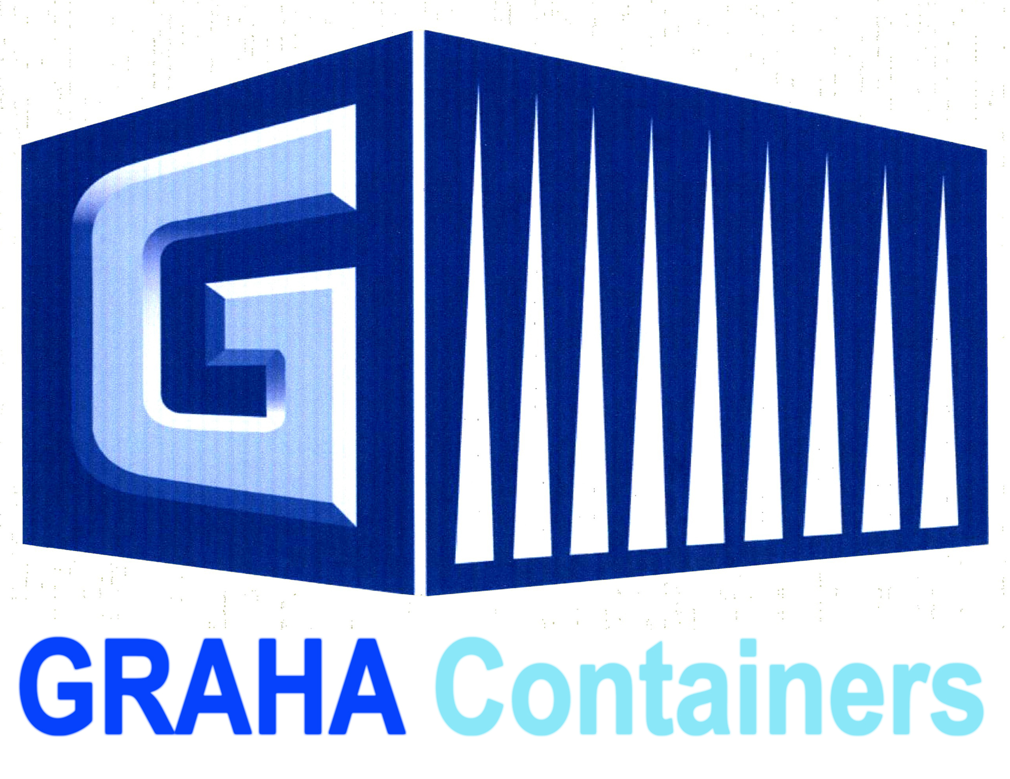













































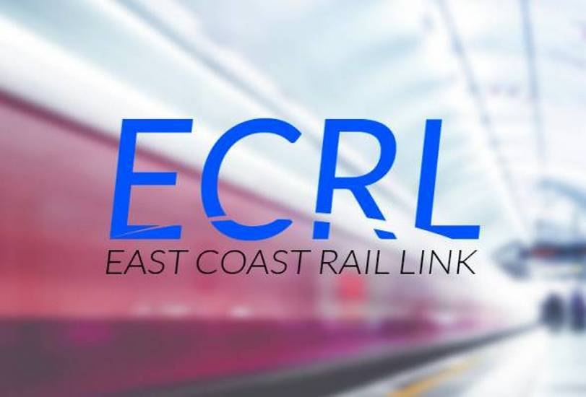
















Scenario 1: IT consolidation and simplification
medium size manufacturing, hotel, logistics, local PA, hospital, Tier 2 FSI, Retail
Notes:
aCMP: Multinet
DR: WCE, Secui

Slide 22
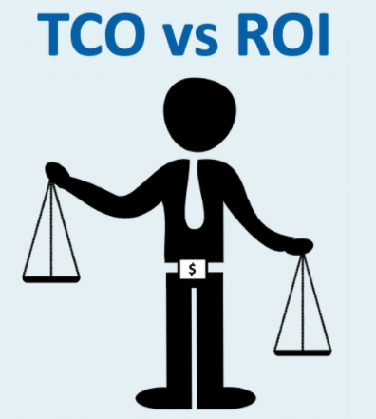




Scenario 2: Cloud Service Provider
Sales triggers
TCO reduction
Public Cloud threat
efficiency of IT
Simplify Cloud operation
USP of Sangfor HCI and Cloud
Lower TCO and simple cost calculation
Attractive on-premise HCI combined with Cloud-based DR solution, empowers local CSP/ISP to compete with public cloud service provider leveraging local services
Shared IT pool but secured, reliable with high performance
Easy to start cloud service offering with general IT professionals and efficient operation model
Notes:
Sales triggers
Wants to utilize public cloud, but has legacy applications that are not fit to be run in public cloud, or has concerns for data security and data proximity
ISPs or MSPs who are looking for private cloud or local public cloud
Big corporates who are looking for multi-tenancy and more automation in their on-premise data centers
aCloud values
1-stop enterprise cloud built on the industry-leading HCI platform
A cloud that’s extremely easy to set up and manage
A cloud that keeps evolving and moves your business up in the stack to avoid fierce infrastructure competition

Slide 23
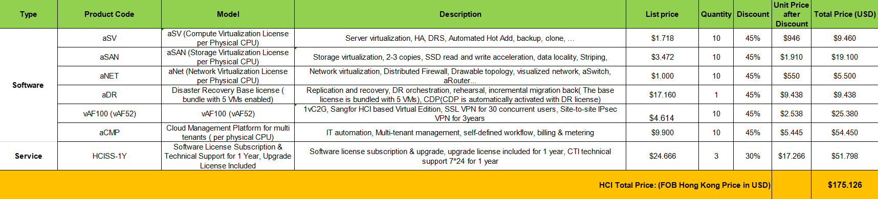
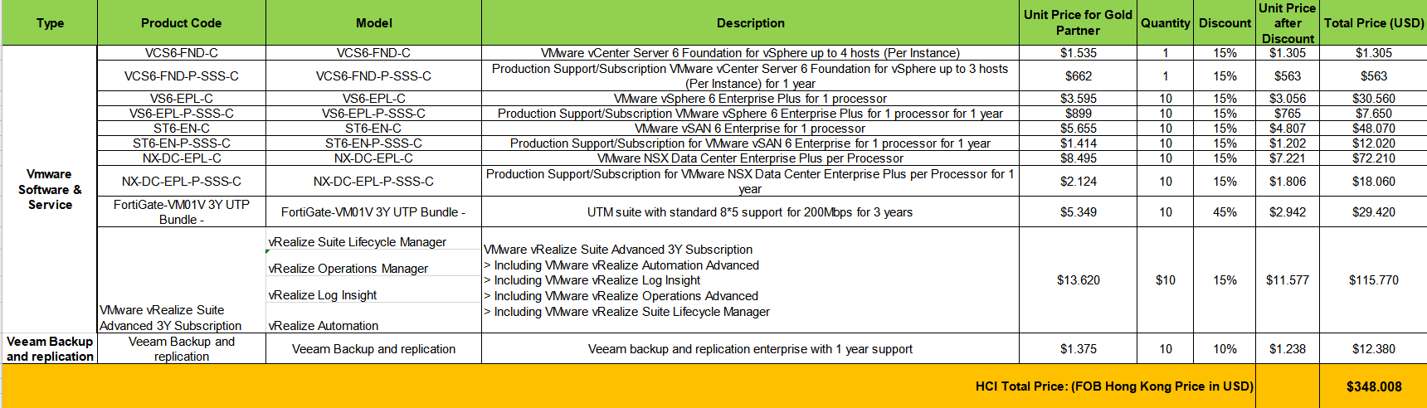
The bigger scope the bigger the difference
CSP/large Enterprise/central government
Notes:
LOGO化, business values
Legacy servers have been running more than 3 years, lacking of performance or capacity
Physical servers or standalone virtualized servers with no shared storage, no HA or backup
No technical professional or only 1-2 people managing the whole data center
N-tier consolidates to 1-tier, massive hardware footprint reduction
Scale-out architecture with no performance or capacity compromise
Built-in HA and integrated backup to guarantee business continuity and data integrity
Intuitive web-based management console, massively reduce O&M workload

Slide 24
Case Sharing: Multinet
Customer overview
Multinet Pakistan is 3rd largest ISP in Pakistan.
Business driver
Mature and stable cloud solution with multitenancy and billing capability
Easy to run cloud business as a pioneer of cloud service offering in the country
Affordable TCO to justify business case
Solutions
initially, 4 at Main DC and 2 at DR site with cloud suite equipped.
USPs of Sangfor Cloud Solution:
1. Fully integrated and ready made solution
2. easy to understand and operate
3. affordable TCO to start their business innovation
Notes:
aCMP: Multinet
DR: WCE, Secui

Slide 25












Some CSPs customers

Slide 26
Sales Strategy in Europe
/developped countries in MEA
Focus on hunting big customer names at any cost and focus on revenue generation in SMB/SME, mid-market and Public sector.
Revenue generator
SME/SMB: 2-4nodes, HCI with ES and NGFW in all industries
Medium size Manufacturing companies
Local/central Public Administrations, Universities, Hospitals
Brand image setting with Enterprise and central government and CSP/ISPs
Notes:
67家渠道卖了2单及以上aCloud 渗透率2.5%
83家卖过1单
总共2605家渠道
卖过aCloud的渠道 5.75%

Slide 27

THANK YOU !

