Slide 1

nCSSV product introduction
www.nexavm.com
August 16, 2025
Presented by Giacomo

Slide 2
01
Features

Slide 3
01
Features
Simple - Lightweight Private Cloud
One - click download, complete installation and deployment within 30 minutes
One - physical machine can build a POC environment
One- management node is sufficient to manage the entire cloud platform
One - operation and maintenance personnel (with general capabilities) can easily perform O&M
One - click inspection for all - round health check and scoring
Guided operation prompts, with rich automated O&M functions
NexaVM nCSSV
SaaS
PaaS
IaaS

Slide 4
01
Features
Strong —— A stable and efficient system architecture design
Full Asynchronous Design
Lock - free Architecture
Stateless Service
Fault Self - recovery
Thousands of threads can easily handle 10,000 concurrent tasks generated when creating 1 million virtual machines; a single computing node can easily manage 10,000 + servers.
The management node only processes requests without retaining states, enabling horizontal seamless scaling. Operation requests are automatically load - balanced. In extreme failure situations, the entire cloud platform can be quickly rebuilt.
Operations on different objects are processed in parallel, while operations on the same object are processed in series; it eliminates performance issues caused by distributed locked architectures and improves the processing performance of the cloud platform.
Multiple high - availability judgment mechanisms accurately identify whether a computing node fails, and automatically restart cloud hosts on other computing nodes to ensure business continuity.

Slide 5
Features
Scalable - Uniformly manage all kinds of resources and deliver on demand
01
Management: Heterogeneous Resource Platform Management
Can simultaneously manage NexaVM computing clusters, VMware vCenter resource environments, and AWS Cloud public cloud environments
Multi - cloud Management Platform
PaaS Platform
OA System
Resource: On - Demand Delivery of Business Resources
Provides load balancing, elastic scaling, and dynamic scheduling to achieve elasticity and on - demand usage of business resource requirements.
NexaVM Cloud Management Platform
Openness: Open Cloud Platform
Provides standard HTTP Restful APIs to connect with third - party cloud management platforms, PaaS platforms, and OA systems.
VMware Resource Environment
AWS Cloud Public Cloud
NexaVM nCSSV Cluster
Efficient Management - to - Computing Ratio
High - efficiency management - to - computing ratio. One management node can manage 10,000 computing nodes.
Local Storage
NAS/SAN
nSAN
AWS Cloud NAS

Slide 6
01
Features
Smart —— Easy to Use and Focused on Enterprises’ Long - term IT Development
Seamless Upgrade
NexaVM Cloud 2.x
Seamless Upgrade
Seamless Upgrade
Latest Version
NexaVM Cloud 1.x
NexaVM Cloud 3.x
Software is designed from the beginning to support smooth upgrade.
the platform has open APIs for being integrated by billing system, operational system and other business systems as per requirements from the market.
you may find lots of scripts on terraform github to automate operations across vendors and cloud platforms

Slide 7
01
Features
Product highlights
Independent Intellectual Property Rights
One-Click Seamless Upgrade
Quick Installation and Deployment
Supportive of Existing Servers and Hardware-Independent
High Availability
Rich and complete functions
A complete self-developed and innovative cloud that is open-source with key code, autonomous, and controllable.
Allows you to perform one-click cross-version upgrades without affecting your business continuity.
Allows you to download NexaVM Cloud Enterprise from the official website and install the cloud on physical servers within just 30 minutes.
Allows you to deploy NexaVM Cloud Enterprise on devices that uses the x86 architecture and supports CPU virtualization.
Isolates management planes from data planes to avoid a single point of failure. Backup management nodes will be applied within seconds if any management node is disconnected, thus ensuring your business continuity.
Building on core IaaS functions (computing, networking, storage), it offers heterogeneous virtualization management, enterprise management, disaster recovery, elastic bare - metal management, visual resource orchestration, and an app center to meet unified cloud platform O&M and operation needs.

Slide 8
01
Features
nCSSV: Hypervisor features
1. Hypervisor features
HA
Dynamic Resource Scheduler
Vmotion
Hot migration
Bulk Actions on VMs
Physical and virtual GPU support
create and restore Snapshot
support 1000+ nodes in 1 cluster
support most types of storages：local/NFS/NAS/CEPH/SAN（FC/iSCSI）
support manage vmware vCenter

Slide 9
01
Features
nCSSV: SDN features
L2 virtual switch
virtual router
VXLAN pools
VPC network
HA of Virtual Routers
Virtual IP and Elastic IP
Network layer loadbalancing
Network firewall for south-north traffic
dynamic routing protocol: ospf
IPsec VPN
SDN Controllers
Microsegementation with distributed firewall for east-west traffic segmentation
Network topology visibility

Slide 10
01
Features
nCSSV:Cloud Management features
Multi tenant support
Billing
Application market
Support organization/user/usergroup/role in tenant management
ticketing system for resource application process
Bare metal management
Elastic bare metal management
Container Management
Hybrid cloud Management

Slide 11
02
Scenarios

Slide 12
02
Scenarios
Virtualization+
Scenario Solution
server hardware virtualization
multi tenant for cross department or for Cloud Service Providers
Customer Value
increase hardware utilization 3-5 times efficiency compared to physical servers
Cut down hardware costs, data center costs, and electricity costs
shared infra for multiple departments and companies
VM
VM
VM
VM
VM
...
VM
VM
NexaVM Cloud platform
NexaVM Cloud
Computing node
NexaVM Cloud
Computing node
NexaVM Cloud
Computing node
...
Server
Server
Server
The performance of cloud hosts is close to that of physical machines with the same configuration
95%-99%
90%-93%
90%-95%
97%
CPU
Memory
networking
storage

Slide 13
02
Scenarios
Heterogeneous Platform Management & Multi-Region Governance
Organization A
Project A
Resource A
Organization B
Project B
Resource B
Organization C
Project C
Resource C
customer requirements
one management for multi brand of hypervisors，baremetal machines，public cloud
Solution
nCSSV cloud management with hypervisors integrates
nCSSV cloud management integration with other brands or public cloud service providers
NexaVM nCSSV Platform
NexaVM nCSSV Cluster
VMware vCenter
AWS Cloud Public Cloud

Slide 14
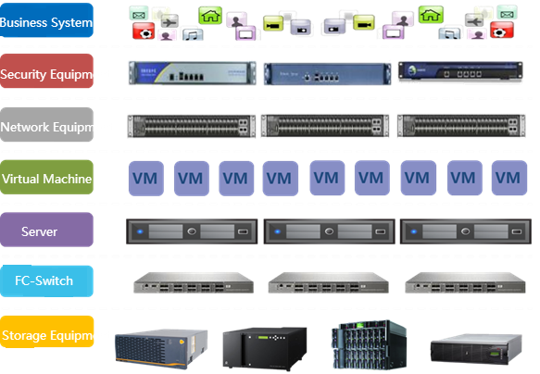

02
Scenarios
Hyper Converged Infrastructure
Hyperconvergence Architecture
Compute
Storage
Network
Security
Traditional Hardware Architecture
Few nodes consolidates all hardware products
Huge TCO and TTM reduction

Slide 15
02
Scenarios
Innovation Business Enablement Platform
Scenario Solution
Deliver GPU - type cloud hosts via GPU passthrough and GPU virtualization;
Deliver physical server computing engines through bare - metal management;
Support application scenarios such as big data, artificial intelligence, and high - performance computing (HPC);
Customer Value
Reduce the operational overhead of basic resources required for innovative businesses;
Shorten the time - to - readiness for basic resources needed by innovative businesses;
Provide flexible resource scheduling to meet the demands of business innovation and transformation.
Big Data
Artificial Intelligence
High-Performance Computing
...
NexaVM Cloud Platform
NexaVM Cloud
GPU Computing Cluster
Bare-Metal Server
Bare-Metal Server

Slide 16
03
Reference case

Slide 17

Thux SRL in Italy
Business Challenge
Thux has 3 data centers and offering managed IaaS. however, it needs to stay competitive on service prices towards their customers. However, vmware price is too high and will detroy their business, other vendors are not technically good enough and opensource solution requires too much workforce to maintain and eventually costs more with the growth of the business.
NexaVM Solution
NexaVM nCSSV with nSAN meet their requirements as Cloud service provider. enable them to be able to offer IaaS/PaaS/DaaS at good price point.
Any type of external storage is compatible with the hypervisor
Terraform scripting makes their operation easy for large scale provisioning and automation.
Migration from vmware to NexaVM is smooth and simple

Slide 18
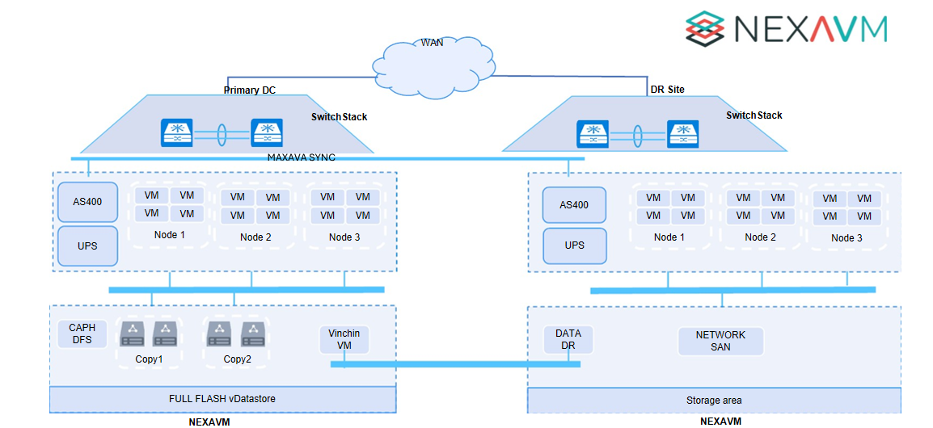
Baomarc Car manufacturing In Torin Italy
Business Challenge
Old 3 Tier infrastructure with basic vmware hypervisors
old hardware of servers, storage and storage networks
only 1 IT resource managing all products for 3 subcompanies
limited budget caused by the shrink of automotive business since 2023
Project Solution and benefits
☁️ NexaVM Converged Cloud Deployment : new NexaVM Cloud platform with HCI enabled
hardware consolidated from 10 nodes to 3 nodes.
each country could manage their own workload independently
1 week training on the internal IT staff able to manage the complete infrastructure.
60% reduction in TCO compared with the existing IT spending

Slide 19




Thanks
Lugano, Switzerland
www.nexavm.com
sales@nexavm.com

