Slide 1

NexaVM nDesk VDI
Seamless Desktop Experience, Secure and
Efficient Digital Workspace
www. nexavm.com

Slide 2
Agenda
PART 1
Business Challenges
PART 2
NexaVM nDesk VDI Introduction
PART 3
VDI Value Summary
www. nexavm.com

Slide 3
Part: 01
Business Challenges with Traditional Desktops
www. nexavm.com

Slide 4



Security is not Enough on Desktop Endpoints
Users are most vulnerable assets
Data Leakage
by Internal Users
Data Lost due to Disk Failure
www. nexavm.com

Slide 5
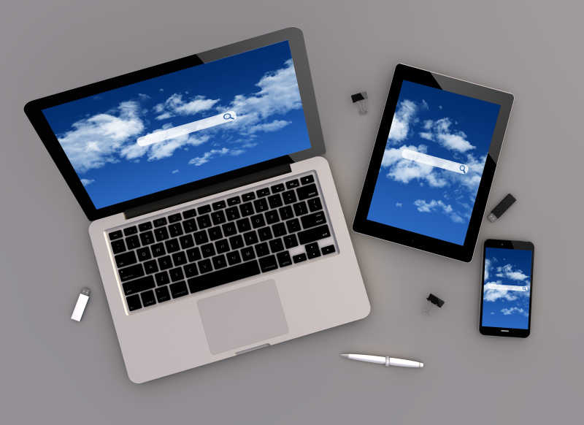

Digital Transformation is Driving New Requirements
50%
Difficulty in Keeping Data Consistent in different type of End User Devices
Almost half of the Users will Continue to Work From Home, after the COVID-19 Pandemic
Increasing Partners and Outsourcing, making temporary and secure access difficult
-- Gartner
www. nexavm.com

Slide 6
Inefficient IT Operations & Management
Hardware PC
Environment Initialization
Policy & Troubleshooting
Software Management & Update
Short Hardware Life Cycle
Long Cycle Hardware Replacement
Data Protection
Assets Recycle
Entry
Management
Maintenance
Decommission
User waste 2 hours for IT ready
100 PCs per IT Engineer
Business Interrupted 4-8 hours per User every year
Idle Assets
www. nexavm.com

Slide 7
Part: 02
Introduction to NexaVM nDesk Solution
www. nexavm.com

Slide 8



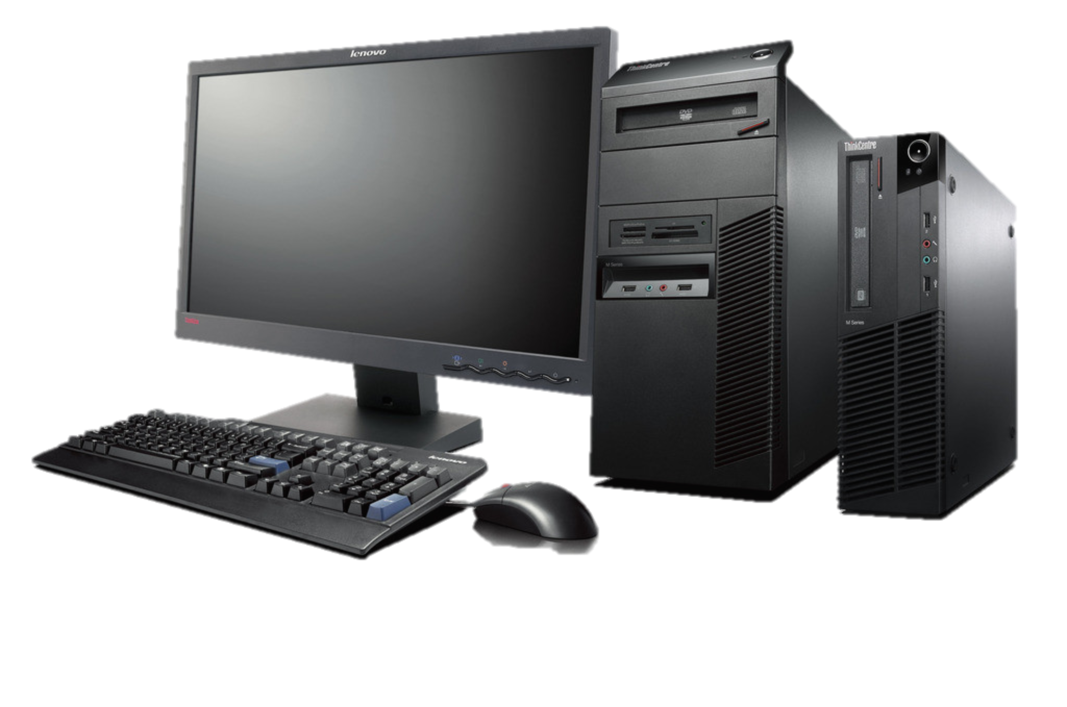




VDI is the Ideal Solution to these Challenges
Data is stored and secured in the cloud
Centralized
management
Data Security
Operations
Virtual Desktops
VM
VM
VM
Flexibility
Scale on-demand Work from anywhere
Desktop, applications, and data are
migrated to cloud (data center)
Desktop Image Delivery
Thin Client
Laptop
PC
Mobile
www. nexavm.com

Slide 9





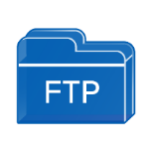


NexaVM nDesk | Architecture
Provides a one-stop secure, efficient, and resilient workspace solution
For business transformation.
User
Access
Usage Scenarios
Identity Management
Secure Office
Remote Work
R&D
Call Center
Production
Line
Flexible Design
Auth
Local/AD/LDAP
Features
Desktop
Image
Multi-Tenant
2D / 3D
Centralized
Sync
NexaVM or 3rd Party Thin Client
Desktop Controller
Business Applications
Hypervisor
Encryption
User
NexaVM
OpenStack
SmartX
API
Resource
Reuse existing Desktop or Laptop
Hardware
Policy
CPU
RAM
Disk
GPU
Network
www. nexavm.com

Slide 10
VDI is Popular in Many Industrial Sectors
General Enterprise
Education
Manufacturing
Secure Office
Remote Work
Call Center
R&D Department
Production Line
Product Design
University Computer Lab
E-Library
BFSI
Government
Healthcare
Secure Office
R&D Department
Service Hall
Secure Office
Service Hall
Remote Work
Doctor’s Office
Nurse Station
Reception
www. nexavm.com

Slide 11
Feature Offerings of NexaVM nDesk Solution
Data Security
Efficiency Improvement
Resilient Solution
DLP Solution (Watermark, Peripheral Control)
Desktop Backup
Encrypted Transmission
Disk Error Protection
Centralized Data in HQ
Unified Management Solution for VDI Servers, Thin Client and VDI Software
Standard Delivery Solution
Desktop Management
Multi-Tenancy
Elastic & Shared Solution
Remote Work Solution
Reutilize existing investment on PCs
Temporary Work Solution
2D and 3D Solutions
Lightweight Solution
www. nexavm.com

Slide 12


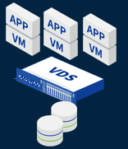



End-to-End Security Protection
User
Client
Desktop Controller
Server & Virtualization
Security for Behavior
Access Security
Network Security
Built-in Security
Screen Watermark
Anti-Screenshot
Exported Document Audit
Clipboard Control
Peripheral Control
Bandwidth Control for peripherals
Endpoint Environment Check
Various User Authentication
Anti-Brute Force Attack
Encrypted Tunnel from End Terminal to Virtual Desktop
Secure and Encrypted Access
Anti-MITM & Brute Force
SD-WAN Gateway & Reverse Proxy
Micro-Segmentation/ Security Groups
Multiple Backup Copies
Disaster Recovery
Built-In WAF in Hypervisor
Disk Signature
Disk Encryption
Captcha Authorization
www. nexavm.com

Slide 13






Unified VM Management to enhance IT Operations
Dedicated Desktop
Education Software
Hospital System
3D Design Software
Office Apps
…
Derive Multiple VMs
within Minutes
Cloned VMs for Users
Template VM
Restored Desktop
Pool Desktop
www. nexavm.com

Slide 14

















Convenient GPU Resource Distributed for 3D Desktops
Smooth
VM
VM
VM
VM
VM
Applications
GPU
Driver
GPU
Driver
GPU
Driver
GPU
Driver
GPU
Driver
AMD / NVIDIA / Huawei vGPU Manager
VDI Running on
HCI Solution
Solution
vGPU Solution
Unified Physical 3D Workspace Management
vGPU
vGPU
vGPU
vGPU
vGPU
Driver
Driver
Driver
GPU Resource (vGPU, Pass-Through, SR-IOV)
vGPU
vGPU
vGPU
Server
www. nexavm.com

Slide 15


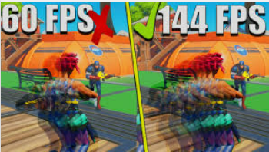
Transmission Optimization Boost User Productivity
Lossless coding
Up to 8K
2D 60 FPS 3D 144 FPS
High Quality
High Resolution
High Frame Rate
NexaVM xLink Protocol
Low Bandwidth
Low Interframe Space
Low Cursor Lagging
2D < 90Kbps
14MS
56 PXs
3D < 1.8Mbps
4MS
18 PXs
www. nexavm.com

Slide 16
High Quality & Efficient Support & Services
Onsite + 24/7 Remote Support
Enhanced Development
One-Stop Solution for Complete Hardware & Software
Strong RND Capability
1-2 Firmware Release Every Year
Customization for Individual Requirements
www. nexavm.com

Slide 17
Part: 03
VDI Value Summary
www. nexavm.com

Slide 18
Value Summary: VDI vs Traditional PC
Category | Item | NexaVM VDI | Traditional PC
Security | Data Storage | In backend server Virtual storage cross server with 2-6 copies Disk encryption | Local PC + RAID solution + Disk encryption solution
 | DLP | Watermark, Anti-screenshot, USB Control, Exported File Audit | Integrate and Deploy 3rd Party DLP solution…
 | Network Security | Distributed Firewall for Micro-Segmentation and Security Groups Centrally configured by IT Staff | System firewall Configure by user
Resilient Work | Resource Sharing | Elastic computing, deploy on-demand | Fixed configuration
 | Remote Work | Secure and smooth access from WAN | RDP Solution/ Remote Apps (Unsecure and sluggish)
 | Mobile Work | Windows/MAC OS/Android/iPhone/Linux | Hard to use in mobile devices
www. nexavm.com

Slide 19
Value Summary: VDI vs Traditional PC
Category | Item | NexaVM VDI | Traditional PC
Efficiency | Deployment | Unified environment delivered centrally to multiple users within minutes. | Prepare and configure or Ghost one by one.
 | Operation & Management | Unified management policy Full life cycle application management Remote support for center | N/A or integrate with other solution
Costs | Deployment | Server + Endpoint Device | Personal Computer (PC)
 | IT Staff | 1 IT staff manage up to 500 users | 1 IT staff manage 100 users
 | Electricity Consumption | Server: 600-1000W Thin Client: 20W | PC: 350W
 | Deprecation Rate | 5 Years | 3 Years (Damaged by user, continuous work, non-standard environment)
www. nexavm.com

Slide 20
Value Brought by NexaVM nDesk VDI
Sample for a company with 500 users move from PC solution to VDI solution
Category | Values
IT Staff Costs | Save 3-4 Staffs costs
Electricity Consumption | Save 250,000 KW/Year (Each user save at least 250W/Hour, 8 hours/day, 5 days/week)
Data Breach Loss | Average save 4.44M USD for 1 time successfully prevention (Data comes from third-party report)
Business Interruption or Waiting Time for Environment Loss | Business continuity save more than 2,000 hours per years (Each user 4 hours/year)
Remote & Mobile Work | Increase productivity 20%-50%
www. nexavm.com

Slide 21
Advantages Compared to Other Vendors
Simple architecture with fewer expenses
(Easy deployment, operation, and management)
01
Stronger Multi-Tenancy
Provide Desktop as a Service (DaaS) Model for Service Providers
Cost-effective
Flexible Costing Perpetual or Subscription based, lowering the TCO
Better local support
Faster response
Local Team on Ground
05
02
NexaVM
Advantage
Better compatibility for peripherals
Faster support for new peripherals
R&D working on it to
improve compatibility
04
03
Better user experience
Different advanced protocols
for different network
www. nexavm.com

Slide 22
Digitalize your Workspace with NexaVM
Experience
Solution
POC
Online Demo
Hands On
Tell your Challenges to NexaVM Staff
Consultants will provide the ideal solution
Testing on your environment to Experience the Solution
www. nexavm.com

Slide 23
Thank You!
www. nexavm.com

